Slide 1

CHAPTER 15
REDUCTION OF STATE TABLES STATE ASSIGNMENT
This chapter in the book includes:
Objectives
Study Guide
15.1 Elimination of Redundant States
15.2 Equivalent States
15.3 Determination of State Equivalence Using an
Implication Table
15.4 Equivalent Sequential Circuits
15.5 Incompletely Specified State Tables
15.6 Derivation of Flip-Flop Input Equations
15.7 Equivalent State Assignments
15.8 Guidelines for State Assignment
15.9 Using a One-Hot State Assignment
Problems

Slide 2
Objectives
Define equivalent states, state several ways of testing for state
equivalence, and determine if two states are equivalent.
2. Define equivalent sequential circuits and determine if two circuits
are equivalent.
3. Reduce a state table to a minimum number of rows.
4. Specify a suitable set of state assignments for a state table,
eliminating those assignments which are equivalent with respect to
the cost of realizing the circuit
5. State three guidelines which are useful in making state assignments,
and apply these to making a good state assignment for a given
state table
6. Given a state table and assignment, form the transition table and
derive flip-flop input equations
7. Make a one-hot state assignment for a state graph and write the
next state and output equations by inspection.

Slide 3
15.1 Elimination of Redundant States
Table 15-1. State Table for Sequence Detector
Input Sequence | Present State | Next State |  | Present Output
 |  | X=0 | X=1 | X=0 | X=1
reset | A | B | C | 0 | 0
0 | B | D | E | 0 | 0
1 | C | F | G | 0 | 0
00 | D | H | I | 0 | 0
01 | E | J | K | 0 | 0
10 | F | L | M | 0 | 0
11 | G | N | P | 0 | 0
000 | H | A | A | 0 | 0
001 | I | A | A | 0 | 0
010 | J | A | A | 0 | 1
011 | K | A | A | 0 | 0
100 | L | A | A | 0 | 1
101 | M | A | A | 0 | 0
110 | N | A | A | 0 | 0
111 | P | A | A | 0 | 0

Slide 4
15.1 Elimination of Redundant States
Table 15-2. State Table for Sequence Detector
Present State | Next State |  | Present Output
 | X=0 | X=1 | X=0 | X=1
A | B | C | 0 | 0
B | D | E | 0 | 0
C | F E | G D | 0 | 0
D | H | I H | 0 | 0
E | J | K H | 0 | 0
F | L J | M H | 0 | 0
G | N H | P H | 0 | 0
H | A | A | 0 | 0
I | A | A | 0 | 0
J | A | A | 0 | 1
K | A | A | 0 | 0
L | A | A | 0 | 1
M | A | A | 0 | 0
N | A | A | 0 | 0
P | A | A | 0 | 0

Slide 5
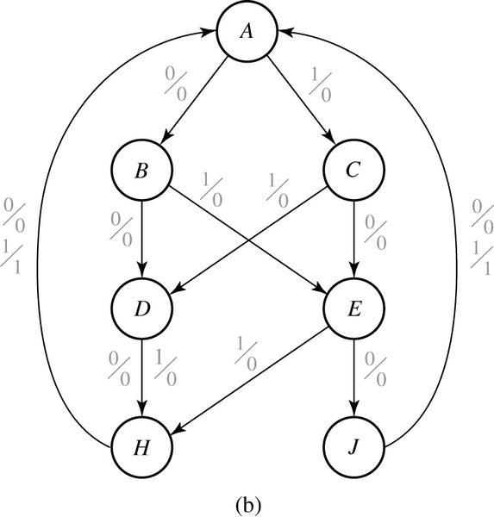
15.1 Elimination of Redundant States
Fig 15-1. Reduced State Table and Graph for Sequence Detector
Present State | Next State |  | Present Output
 | X=0 | X=1 | X=0 | X=1
A | B | C | 0 | 0
B | D | E | 0 | 0
C | E | D | 0 | 0
D | H | H | 0 | 0
E | J | H | 0 | 0
H | A | A | 0 | 0
J | A | A | 0 | 1

Slide 6
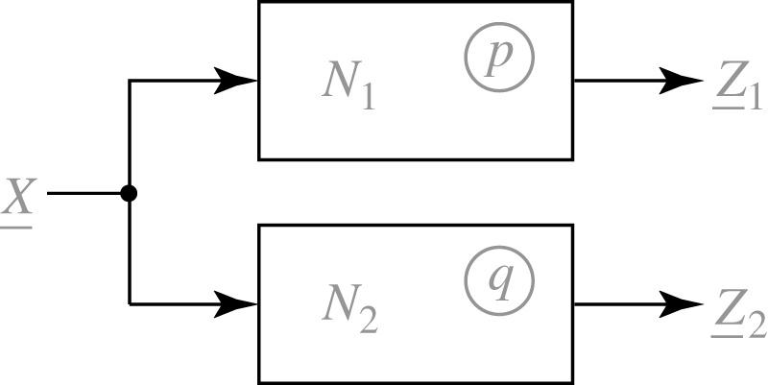




15.2 Equivalent States
Fig 15-2.
Definition 15.1
Let N₁ and N₂ be sequential circuits(not necessarily). Let X represent a sequence of
inputs of arbitrary length. Then state p in N₁ is equivalent to state q in N₂ iff
for every possible input sequence X.
Theorem 15.1
Two states p and q of a sequential circuit are equivalent iff for every single input X, the outputs are the same and the next states are equivalent, that is,

Slide 7
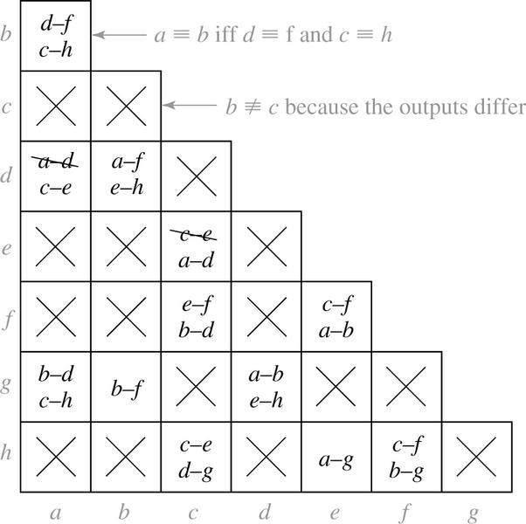
15.3 Determination of State Equivalence Using an Implication Table
Table 15-3.
Fig 15-3. Implication Chart for Table 15-3
Present State | Next State |  | Present Output
 | X=0 | 1 | X=0
a | d | c | 0
b | f | h | 0
c | e | d | 1
d | a | e | 0
e | c | a | 1
f | f | b | 1
g | b | h | 0
h | c | g | 1
By Theorem 15.1

Slide 8
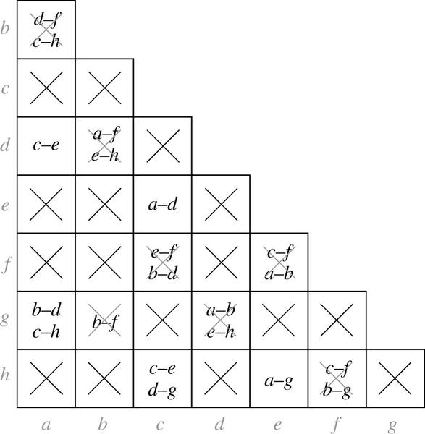
15.3 Implication Chart After First Pass
Fig 15-4. Implication Chart After First Pass

Slide 9
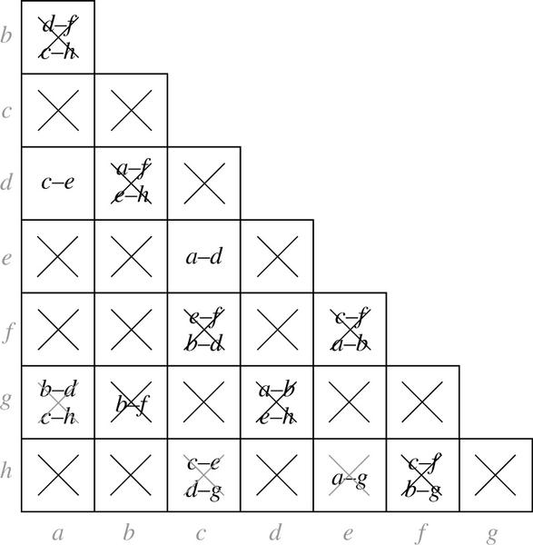
15.3 Implication Chart After First Pass
Fig 15-5. Implication Chart After Second Pass
Table 15-4.
Present State | Next State |  | Output
 | X=0 | 1
a | a | c | 0
b | f | h | 0
c | c | a | 1
f | f | b | 1
g | b | h | 0
h | c | g | 1

Slide 10


15.4 Equivalent Sequential Circuits
Definition 15.2
Sequential circuit N₁ is equivalent to sequential circuit N₂ if for each state p in N₁ , there is a state q in N₂ such that , and conversely, for each state s in N₂ , there is a state t in N₁ such that

Slide 11


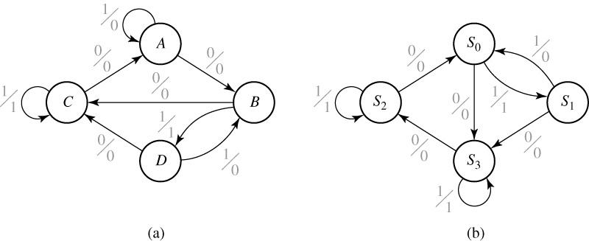
15.4 Equivalent Sequential Circuits
Fig 15-6. Tables and Graphs for Equivalent Circuits
 | X=0 | X=1 | X=0 | X=1
A | B | A | 0 | 0
B | C | D | 0 | 1
C | A | C | 0 | 1
D | C | B | 0 | 0
 | X=0 | X=1 | X=0 | X=1
S₀ | S₃ | S₁ | 0 | 1
S₁ | S₃ | S₀ | 0 | 0
S₂ | S₀ | S₂ | 0 | 0
S₃ | S₂ | S₃ | 0 | 1

Slide 12
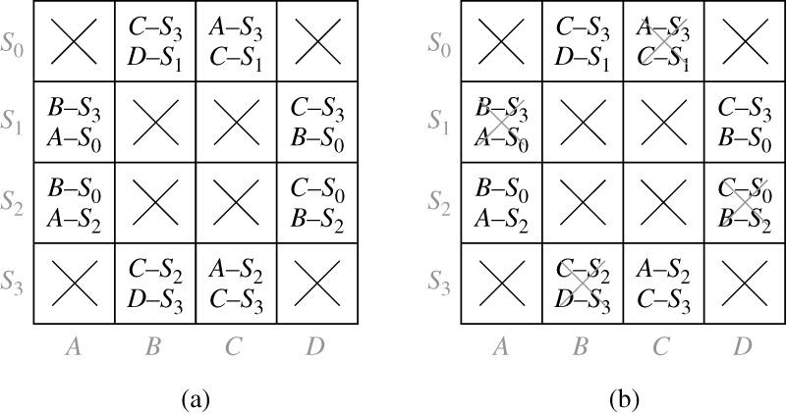

15.4 Equivalent Sequential Circuits
Fig 15-7. Implication Tables for Determining Circuit Equivalence

Slide 13


15.5 Incompletely Specified State Tables
Fig 15-8.
The possible input-output sequence for circuit B
 | t₀ | t₁ | t₂ |  | t₀ | t₁ | t₂
X= | 1 | 0 | 0 | Z= | - | - | 0
 | 1 | 1 | 0 |  | - | - | 1
(- is a don’t care output)
Table 15-5. Incompletely Specified State Table
 | X=0 X=1 |  | 0 1
S₀ | ₋ | S₁ | - | -
S₁ | S₂ | S₃ | - | -
S₂ | S₀ | - | 0 | -
S₃ | S₀ | - | 1 | -
 | X=0 X=1 |  | 0 1
S₀ | (S₀) | S₁ | (0) | -
S₁ | S₂ S₀ | S₃ | (1) | -
S₂ | S₀ | (S₁) | 0 | -
S₃ | S₀ | (S₃) | 1 | -
 | X=0 X=1 |  | 0 1
S₀ | S₀ | S₁ | 0 | -
S₁ | S₀ | S₁ | 1 | -

Slide 14
15.6 Derivation of Flip-Flop Input Equations
The procedure to drive the flip-flop input equations:
Assign flip-flop state values to correspond to the states in the reduced table
Construct a transition table which gives the next states of the flip-flops as a function of the present states and inputs
Derive the next-state maps from the transition table
Find flip-flop input maps from the next-state maps using the techniques developed in Unit 12 and find the flip-flop input equations from maps

Slide 15
15.6 Derivation of Flip-Flop Input Equations
Table 15-6
ABC | A⁺B⁺C⁺ |  | Z
 | X=0 | X=1 | 0 | 1
000 | 110 | 001 | 0 | 0
110 | 111 | 001 | 0 | 0
001 | 110 | 011 | 0 | 0
111 | 101 | 001 | 0 | 0
011 | 110 | 010 | 0 | 0
101 | 101 | 001 | 1 | 0
010 | 110 | 010 | 0 | 1
 | X=0 X=1 |  | 0 1
S₀ | S₁ | S₂ | 0 | 0
S₁ | S₃ | S₂ | 0 | 0
S₂ | S₁ | S₄ | 0 | 0
S₃ | S₅ | S₂ | 0 | 0
S₄ | S₁ | S₆ | 0 | 0
S₅ | S₅ | S₂ | 1 | 0
S₆ | S₁ | S₆ | 0 | 1

Slide 16
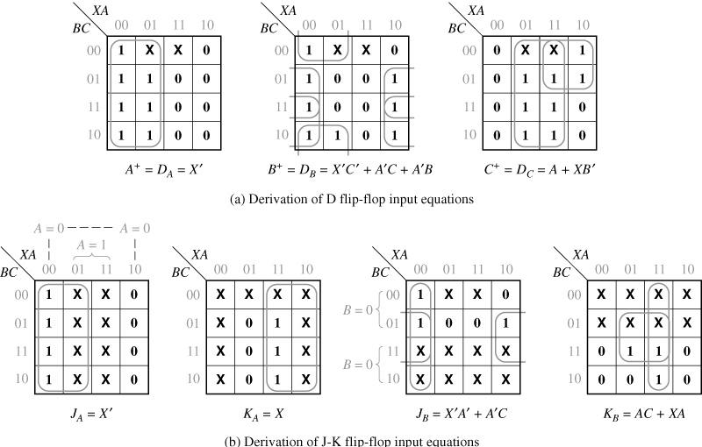
15.6 Derivation of Flip-Flop Input Equations
Fig. 15-9 Next-State Maps for Table 15-6

Slide 17
15.6 Derivation of Flip-Flop Input Equations
Table 15-7
PS | Next State |  |  |  | Output(Z₁Z₂)
 | X₁X₂= |  |  |  | X₁X₂=
 | 00 | 01 | 11 | 10 | 00 | 01 | 11 | 10
S₀ | S₀ | S₀ | S₁ | S₁ | 00 | 00 | 01 | 01
S₁ | S₁ | S₃ | S₂ | S₁ | 00 | 10 | 10 | 00
S₂ | S₃ | S₃ | S₂ | S₂ | 11 | 11 | 00 | 00
S₃ | S₀ | S₃ | S₂ | S₀ | 00 | 00 | 00 | 00
AB | A⁺B⁺ |  |  |  | Output(Z₁Z₂)
 | X₁X₂= |  |  |  | X₁X₂=
 | 00 | 01 | 11 | 10 | 00 | 01 | 11 | 10
00 | 00 | 00 | 01 | 01 | 00 | 00 | 01 | 01
01 | 01 | 10 | 11 | 01 | 00 | 10 | 10 | 00
11 | 10 | 10 | 11 | 11 | 11 | 11 | 00 | 00
10 | 00 | 10 | 11 | 00 | 00 | 00 | 00 | 00
(a) State table
(b) Transition table

Slide 18
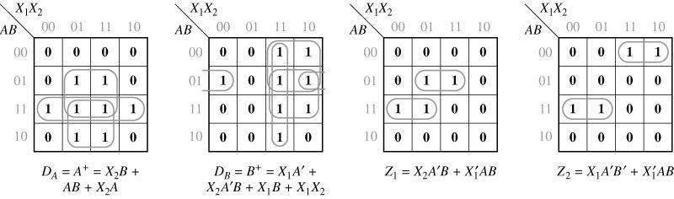
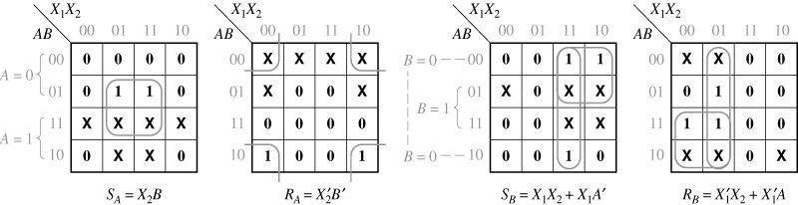
15.6 Derivation of Flip-Flop Input Equations
Fig.15-10 Next-State Maps for Table 15-7
Fig.15-11 Derivation of S-R Equations for Table 15-7

Slide 19
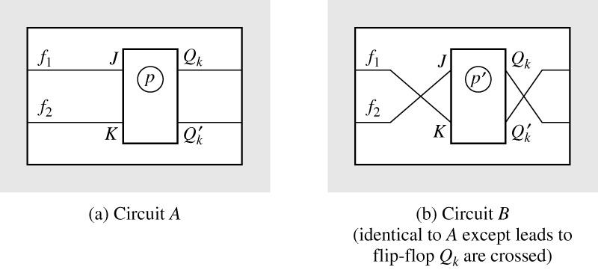
15.7 Equivalent State Assignments
Table 15-8. State Assignments for 3-Row Tables
 | 1 | 2 | 3 | 4 | 5 | 6 | 7 |  | 19 | 20 | 21 | 22 | 23 | 24
S₀ | 00 | 00 | 00 | 00 | 00 | 00 | 01 | … | 11 | 11 | 11 | 11 | 11 | 11
S₁ | 01 | 01 | 10 | 10 | 11 | 11 | 00 |  | 00 | 00 | 01 | 01 | 10 | 10
S₂ | 10 | 11 | 01 | 11 | 01 | 10 | 10 |  | 01 | 10 | 00 | 10 | 00 | 01
Fig. 15-12 Equivalent Circuits Obtained by Complementing Q_{k}

Slide 20
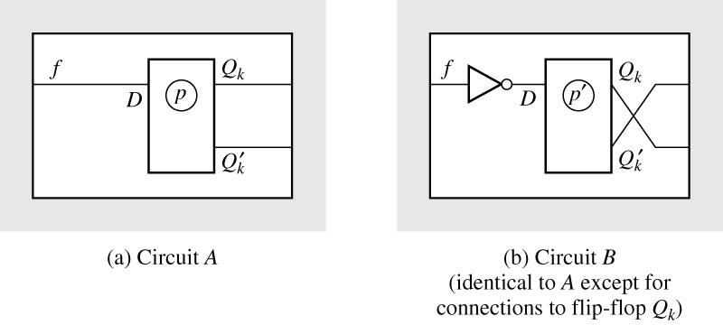
15.7 Equivalent State Assignments
Fig. 15-13 Equivalent Circuits Obtained by Complementing Q_{k}
Table 15-9
Assignments |  |  | Present State | Next State |  | Output
A₃ | B₃ | C₃ |  | X=0 | 1 | 0 | 1
00 | 00 | 11 | S₁ | S₁ | S₃ | 0 | 0
01 | 10 | 10 | S₂ | S₂ | S₁ | 0 | 1
10 | 01 | 01 | S₃ | S₂ | S₃ | 1 | 0

Slide 21
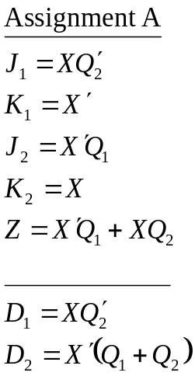
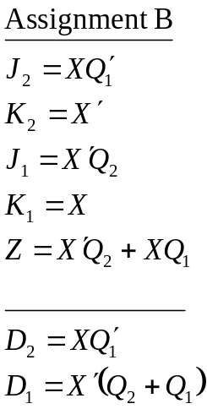
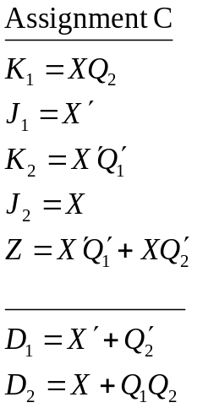
15.7 Equivalent State Assignments
The resulting J and K input equations
Table 15-10 Nonequivalent Assignments for Three and Four States
 | 3-State Assignments |  |  | 4-State Assignments
States | 1 | 2 | 3 | 1 | 2 | 3
a | 00 | 00 | 00 | 00 | 00 | 00
b | 01 | 01 | 11 | 01 | 01 | 11
c | 10 | 11 | 01 | 10 | 11 | 01
d | - | - | - | 11 | 10 | 10

Slide 22

15.7 Equivalent State Assignments
Table 15-11 Number of Distinct(Nonequivalent)State Assignments
Number of States | Minimum Number of State Variables | Number of Distinct Assignments
2 | 1 | 1
3 | 2 | 3
4 | 2 | 3
5 | 3 | 140
6 | 3 | 420
7 | 3 | 840
8 | 3 | 840
9 | 4 | 10,810,800
… | … | …
16 | 4

Slide 23
15.8 Guidelines for State Assignment
Guidelines for state assignment
States which have the same next state for a given input should be given adjacent assignments
States which are the next states of the same state should be given adjacent assignments
States which have the same output for a given input should be given adjacent assignments

Slide 24
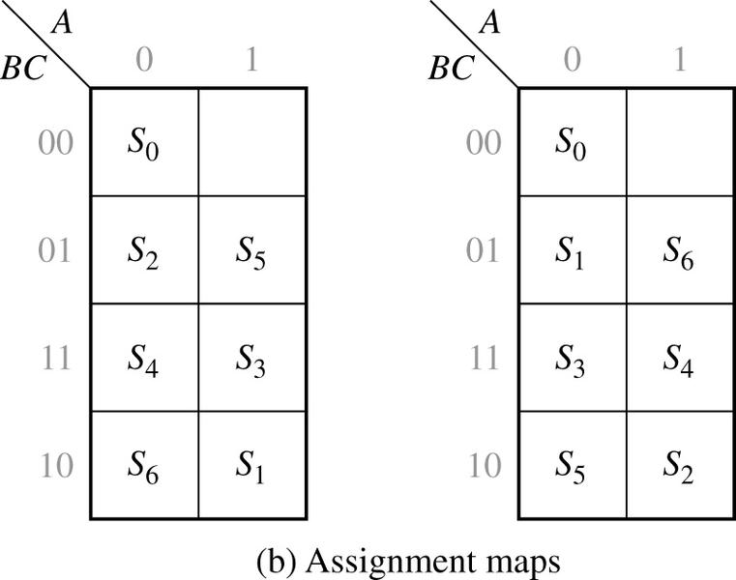
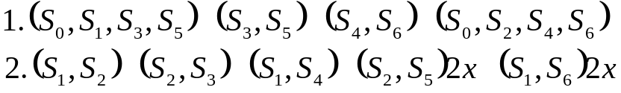
15.8 Guidelines for State Assignment
Fig. 15-14
ABC |  | X=0 | 1 | 0 | 1
000 | S₀ | S₁ | S₂ | 0 | 0
110 | S₁ | S₃ | S₂ | 0 | 0
001 | S₂ | S₁ | S₄ | 0 | 0
111 | S₃ | S₅ | S₂ | 0 | 0
011 | S₄ | S₁ | S₆ | 0 | 0
101 | S₅ | S₅ | S₂ | 1 | 0
010 | S₆ | S₁ | S₆ | 0 | 1
(a) State table
The sets of adjacent states specified by Guidelines 1 and 2

Slide 25
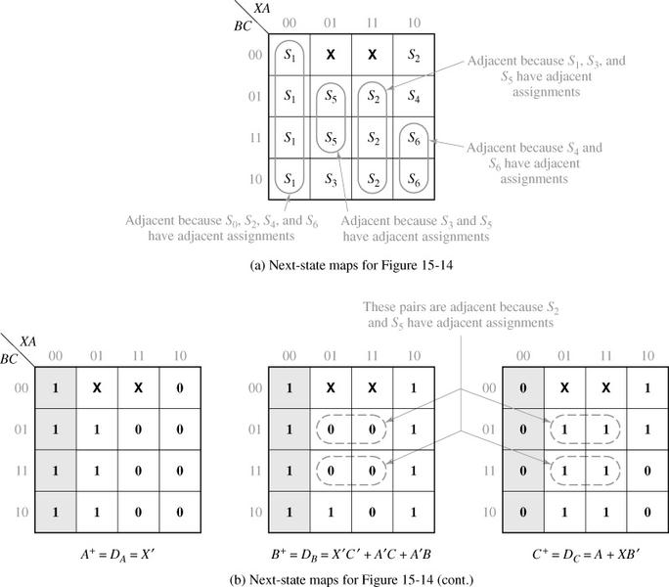
15.8 Guidelines for State Assignment
Fig. 15-15 Next-State Maps for Figure 15-14

Slide 26
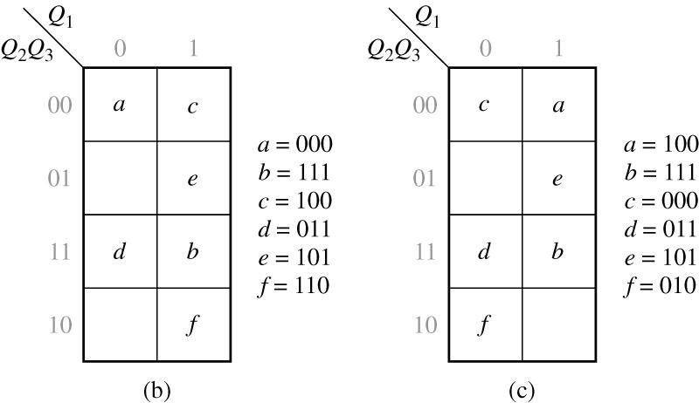
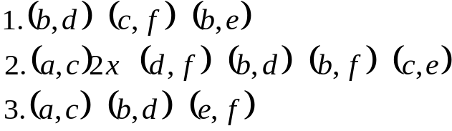
15.8 Guidelines for State Assignment
Fig. 15-16 State Table and Assignments
 | X=0 | 1 | X=0 | 1
a | a | c | 0 | 0
b | d | f | 0 | 1
c | c | a | 0 | 0
d | d | b | 0 | 1
e | b | f | 1 | 0
f | c | e | 1 | 0
(a)
The sets of adjacent states specified by each Guidelines

Slide 27
15.8 Guidelines for State Assignment
Table 15-12 Transition Table for Figure 15-16(a)
Q₁Q₂Q₃ | Q₁⁺ Q₂⁺ Q₃⁺
 | X=0 | 1 | X=0 | 1
1 0 0 | 100 | 000 | 0 | 0
1 1 1 | 011 | 010 | 0 | 1
0 0 0 | 000 | 100 | 0 | 0
0 1 1 | 011 | 111 | 0 | 1
1 0 1 | 111 | 010 | 1 | 0
0 1 0 | 000 | 101 | 1 | 0

Slide 28
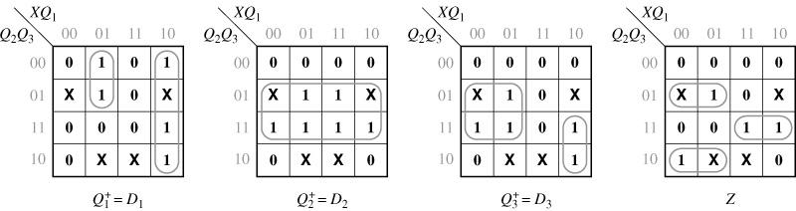
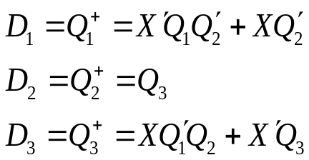

15.8 Guidelines for State Assignment
Fig. 15-17 Next-State and Output Maps for Table15-12
The D flip-flop input equations
The output equations

Slide 29
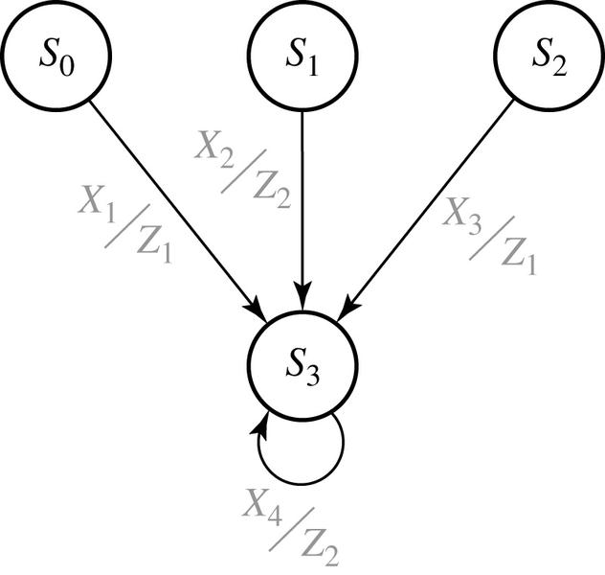

15.9 Using a One-Hot State Assignment
Fig. 15-18 Partial State Graph
The One-hot assignment example
The next-state equation for Q₃
Because Q₀=1 implies Q₁= Q₂= Q₃=0,

Slide 30



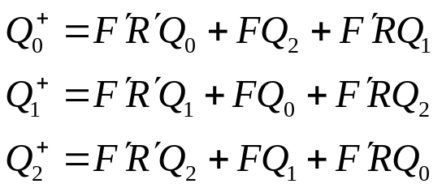

15.9 Using a One-Hot State Assignment
The One-hot assignment example by replacing Q₀ with Q’₀
The modified equations
The next-state equations
The output equations

